Slide 1


Cricket Players
Performance System
(CPP)

Slide 2

Under the guidance of :
Project Team:
Akhilesh Patel
Juhi Sharad Shroff
Naga Shireesha Kamireddy
Rajat Deshmukh
Arun Kumar Seepana
Sivasankaran P
Mr. Rahul Kulkarni

Slide 3

Project Objectives:
Development of a Cricket Players Performance System(CPP)
Performance reports of cricket players of different countries in various types of international match formats according to various factors

Slide 4
Project Flow
Heterogeneous sources i.e.
Operational data(Excel,
Flat files)
SSIS
Extract
Transform
D
A
T
A
S
E
T
Reports Based On Dataset
Data Warehouse
Load

Slide 5
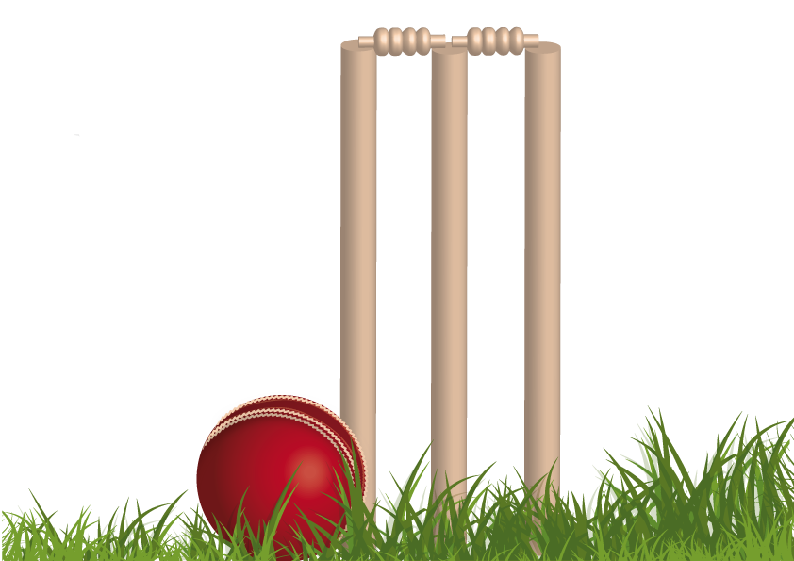
Source Data
Player name
Country name
Matches
Bat Innings
Bowl Innings
Not Outs
Fifities
Hundreds
Highest Score
Runs Scored
Batting Average
Runs conceded
Wickets
Bowling Average
Catches
Stumpings

Slide 6
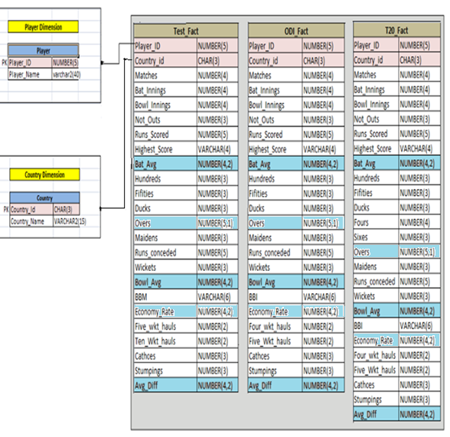
Data Warehouse Star Schema

Slide 7
Staging Tables
Conditional Split
(Source)
Expression
(Trim)
Sort
Staging Area
Source
(Batting)
Source
(Batting)
Conditional Split
(Source)
Expression
(Trim)
Sort
Staging Area
Source
(Bowling)
Conditional Split
(Source)
Expression
(Trim)
Sort
Staging Area
Source
(Fielding)

Slide 8
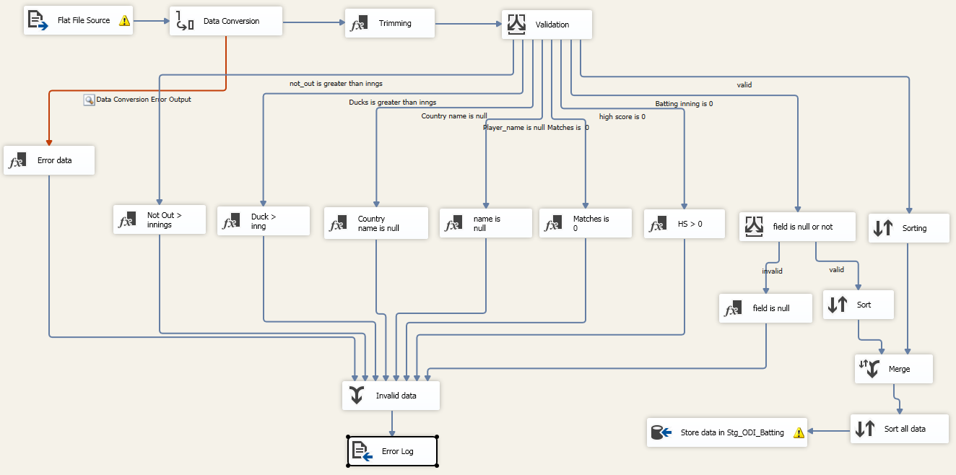
ODI Batting Package

Slide 9
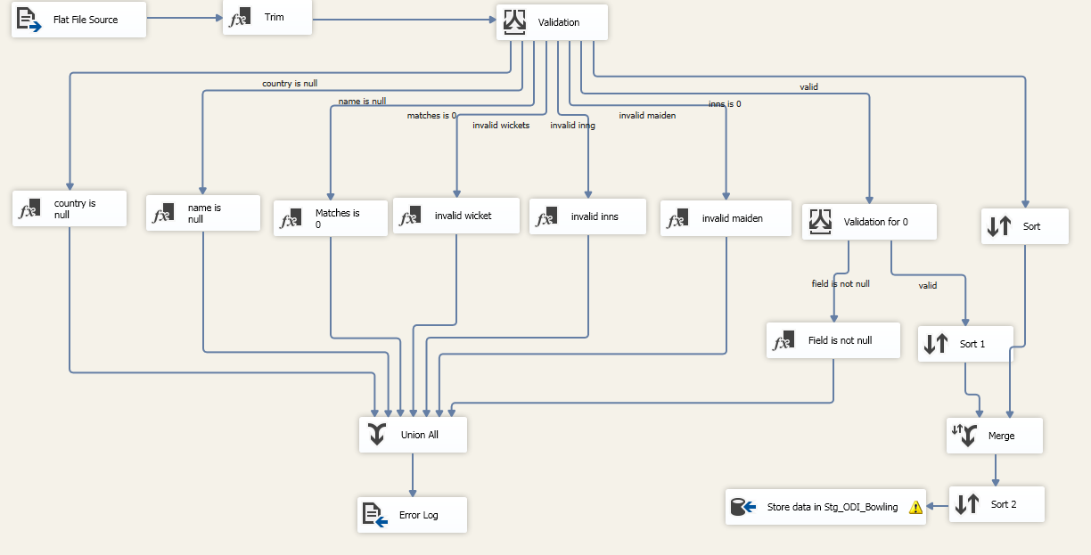
ODI Bowling Package

Slide 10
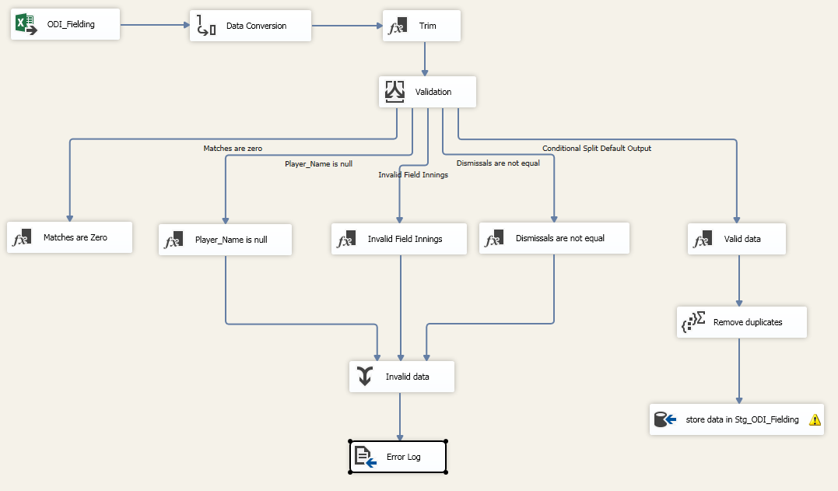
ODI Fielding Package

Slide 11
Creation of Player Dimension Table
OLEDB Cleaned Data Tables
(Source)
Player Dimension
T20 Merged Table
Test Merged Table
ODI Merged Table

Slide 12
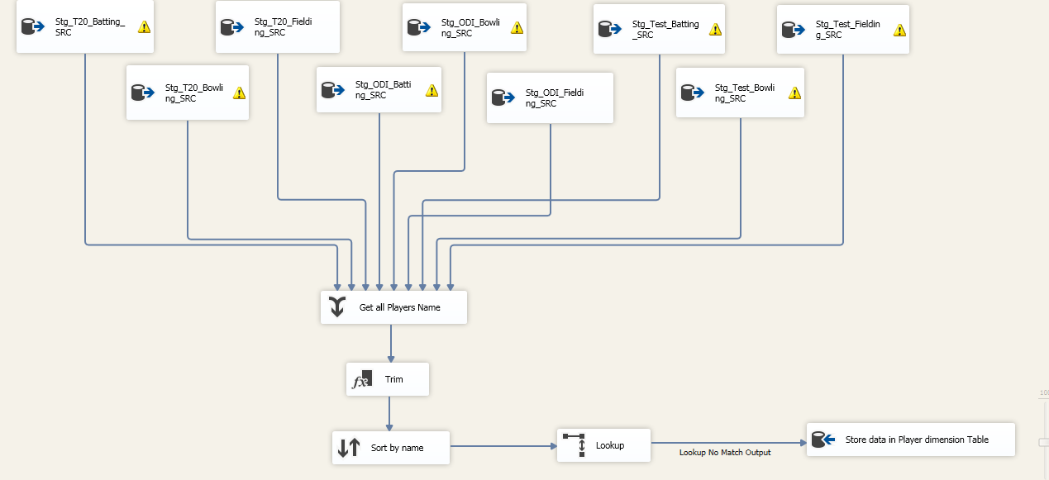
Player Dimension Package

Slide 13
Populating Fact tables
Source
(Staging Area)
Test Fact
ODI Fact
T20 Fact
Player Dimension
(Lookup)
Country Dimension (Lookup)

Slide 14
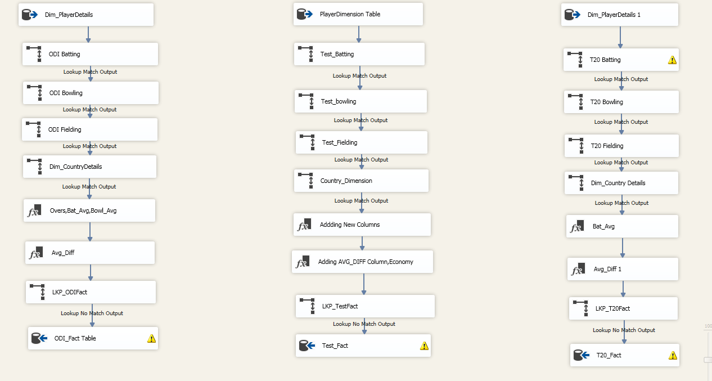
Fact Package

Slide 15
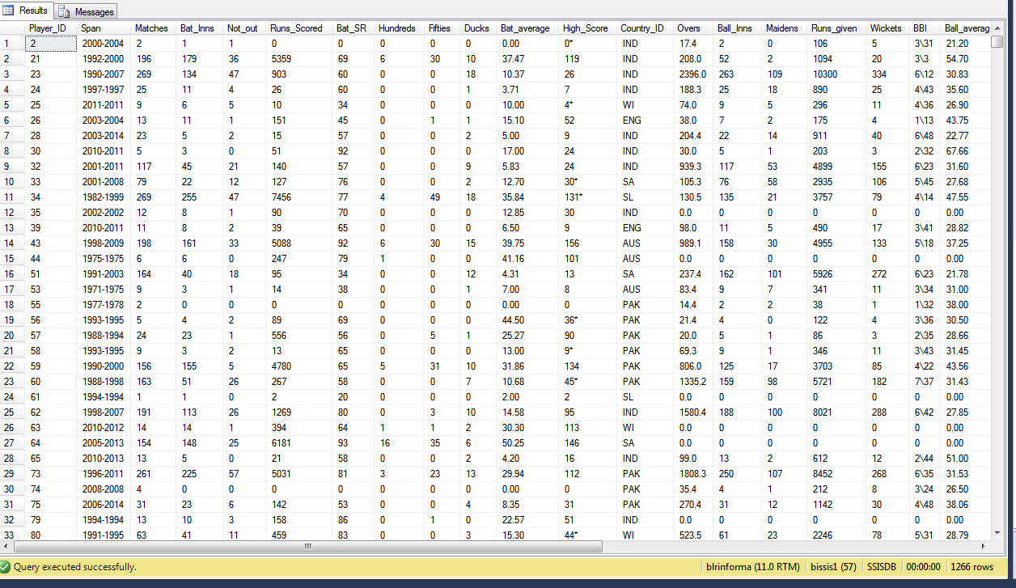
Fact table data

Slide 16
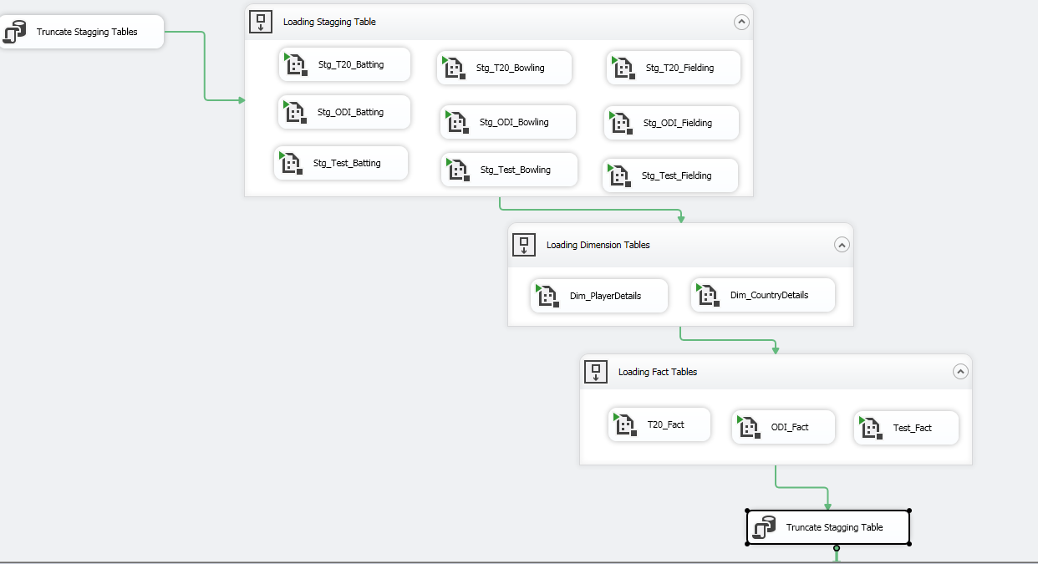
Automation

Slide 17
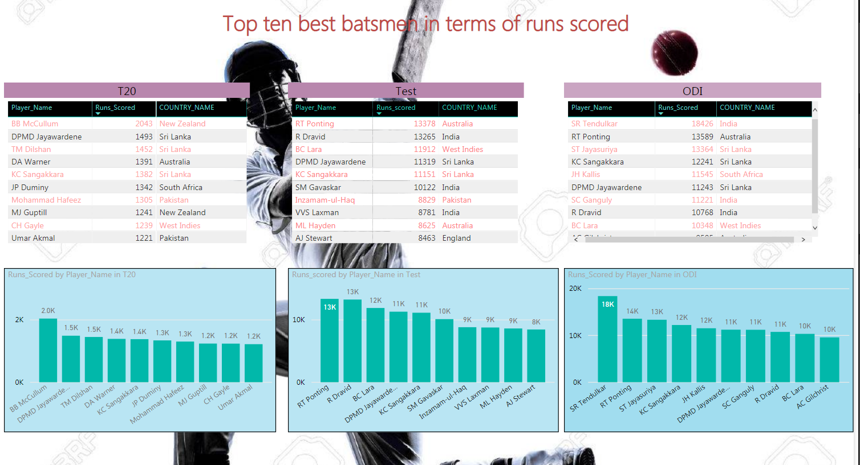
Cricket Performance Analysis Reports

Slide 18
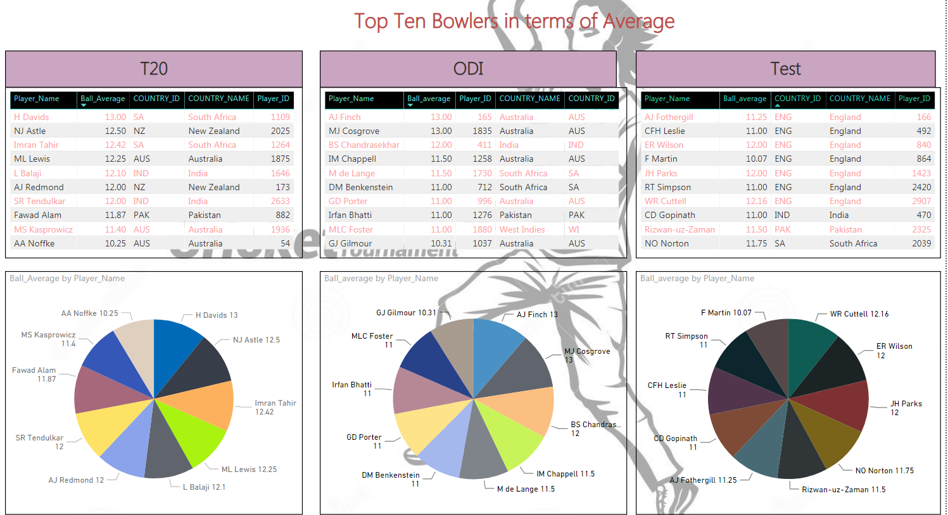

Slide 19
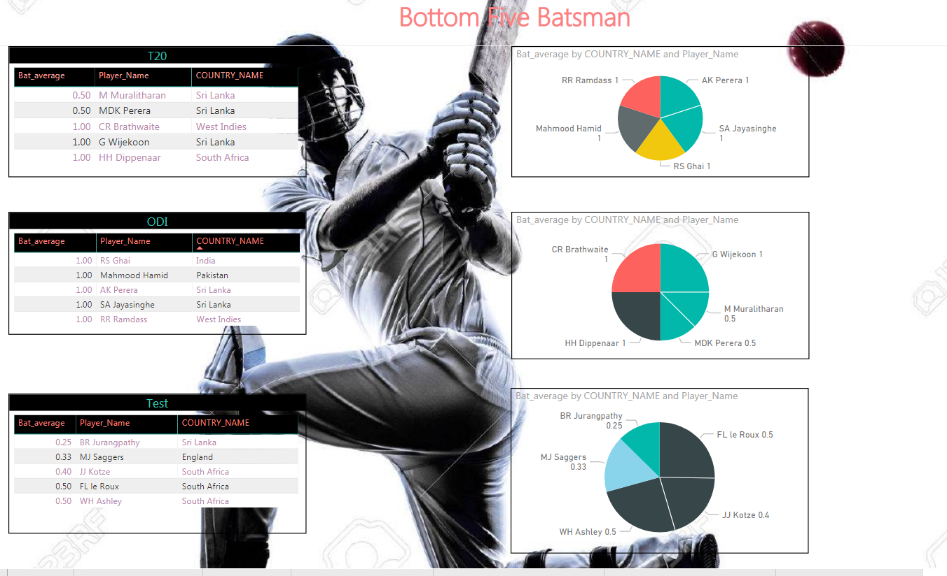

Slide 20
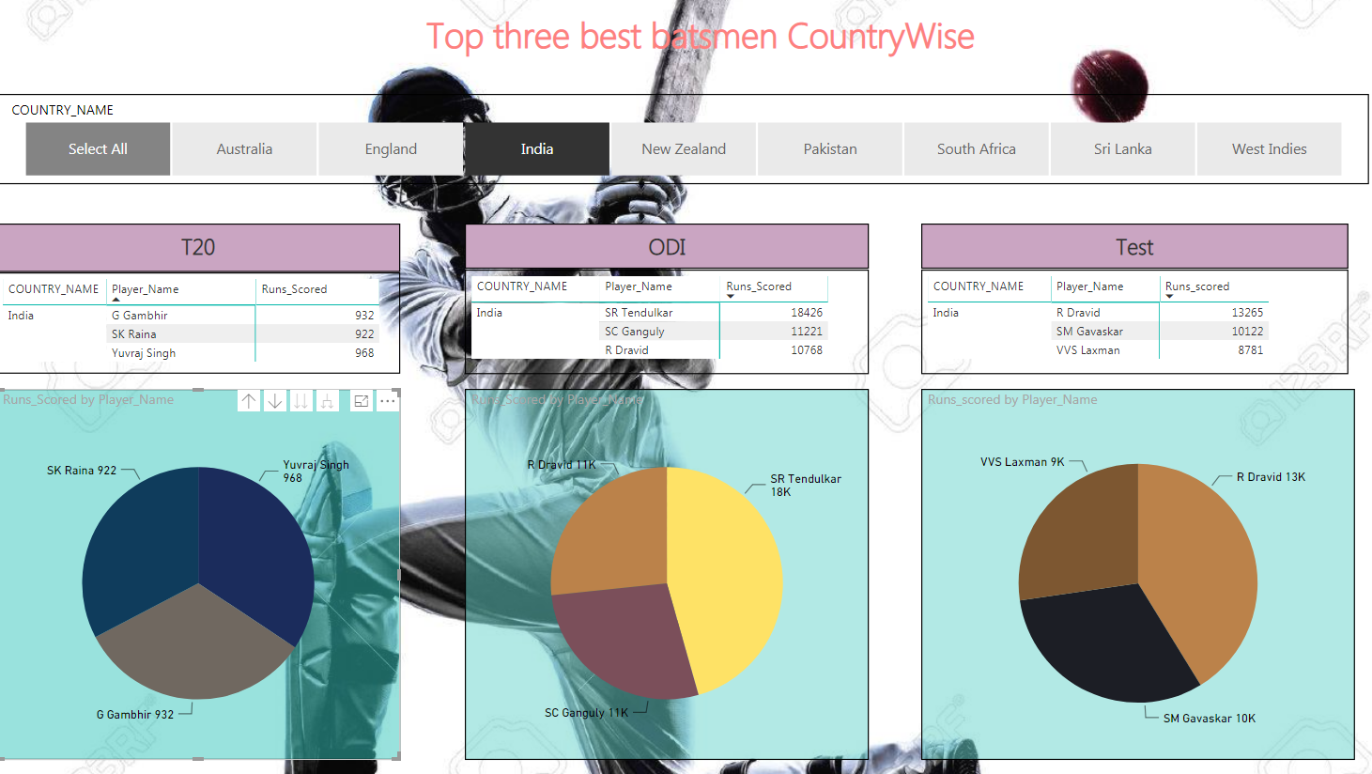

Slide 21
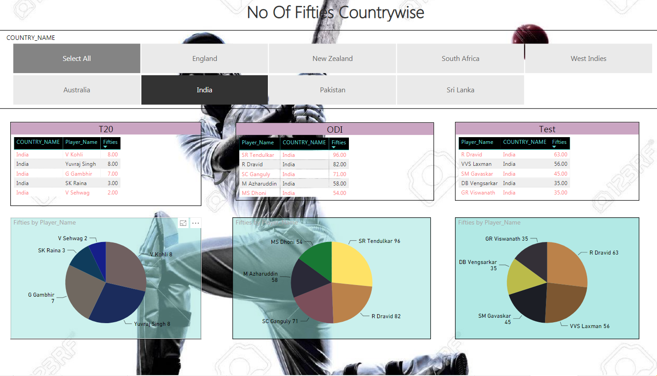

Slide 22
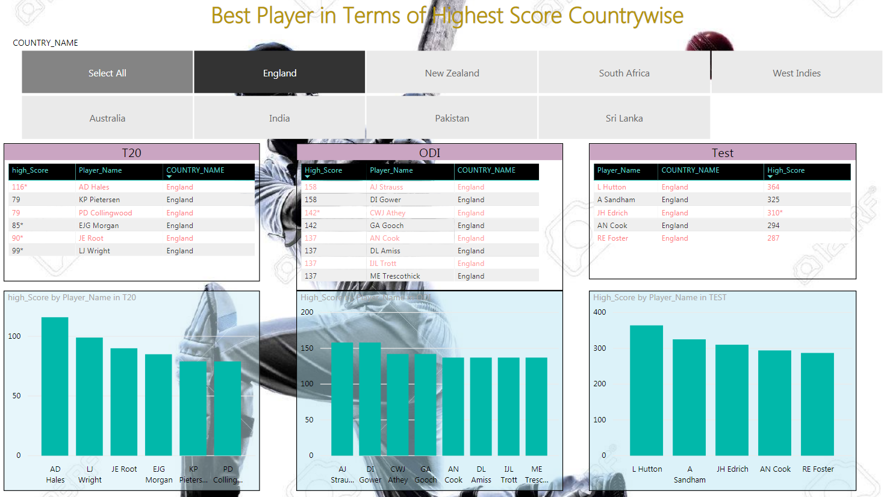

Slide 23


Any Queries?

Slide 24
Thank You

